Slide 1


CMR TECHNiCAL CAMPUS UGC AUTONOMOUS Accredited by NBA & NAAC with A Grade Approved by AICTE, New Delhi and Affiliated to JNTU, Hyderabad
DEPARTMENT OF COMPUTER SCIENCE AND ENGINEERING
MAJOR PROJECT
ON
SECURING DATA IN IOT USING CRYPTOGRAPHY AND STEGANOGRAPHY TECHNIQUES
PRESENTED BY
N. SAI VARDHAN REDDY (167R1A05A0)
ERRABELLI SWETHA (177R1A0513)
NESE YASHWANTH SAI VENKATESHULU (177R1A05M3)
UNDER THE GUIDANCE OF
K. PRAVEEN KUMAR

Slide 2
Abstract
Internet of Things (IOT) is a domain where the transfer of data is taking place every single second. The security of these data is a challenging task; however, security challenges can be mitigated with cryptography and steganography techniques.
These techniques are crucial when dealing with user authentication and data privacy. In the proposed work, the elliptic Galois cryptography protocol is introduced and discussed. In this protocol, a cryptography technique is used to encrypt confidential data that came from different medical sources.
Next, a Matrix XOR encoding steganography technique is used to embed the encrypted data into a low complexity image. The proposed work also uses an optimization algorithm called Adaptive Firefly to optimize the selection of cover blocks within the image. Based on the results, various parameters are evaluated and compared with the existing techniques. Finally, the data that is hidden in the image is recovered and is then decrypted.

Slide 3
EXISTING SYSTEM
Micro Visor Middleware, which uses software virtualization and assembly level code verification to provide memory isolation and custom security.
Energy-Efficient Datagram Transport Layer Security (EEDTLS), which is a low energy variant of Datagram Transport Layer Security (DTLS) that had the same security strength but a lower energy requirement.
Lightweight Break-glass Access Control (LIBAC) system in which medical files can be encrypted in two ways:
Attribute- based access
Break-Glass access

Slide 4
DISADVANTAGES OF EXISTING SYSTEMS
There is no effective secret key used for data hiding.
Less secure cryptographic techniques have been used.

Slide 5
PROPOSED SYSTEM
The proposed system uses the elliptic Galois cryptography (EGC) protocol for protection against data infiltration during transmission over the IOT network.
Different devices in the IOT network transmit data through the proposed protocol as a part of the controller.
The encrypted algorithm within the controller encrypts the data using the EGC protocol and then the encrypted and secured message is hidden in layers of the image, with help from the steganography technique.
The image can then be easily transferred throughout the Internet such that an intruder cannot extract the message hidden inside the image.

Slide 6
ADVANTAGES OF PROPOSED SYSTEM
The Elliptic Galois Cryptography Technique uses the equations from the elliptic curve, so trespassing into the system is harder.

Slide 7
Hardware requirements
Processor : Intel core i3 5th gen
RAM : 4 GB
Space on Hard Disk : 10 GB

Slide 8
Software Requirements
Operating System :Windows 7 or 8
Coding Language :Java-AWT, Swings, Networking
Database :MySQL/MS Access
IDE :Eclipse Galileo
Development kit :JDK 1.6

Slide 9
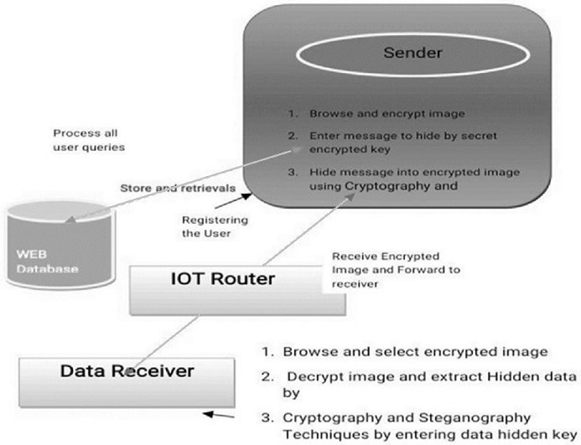
Project Architecture

Slide 10
UML DIAGRAMS

Slide 11
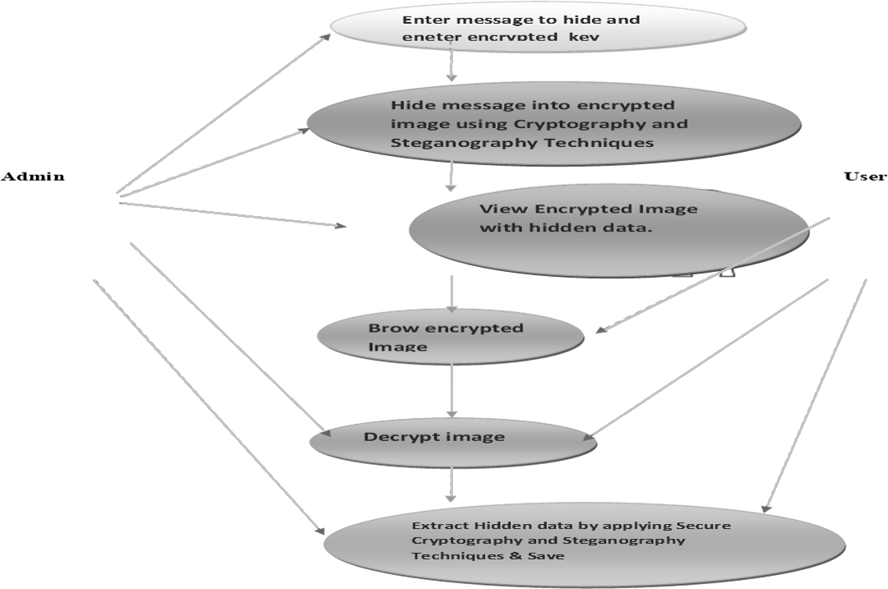
Usecase Diagram

Slide 12
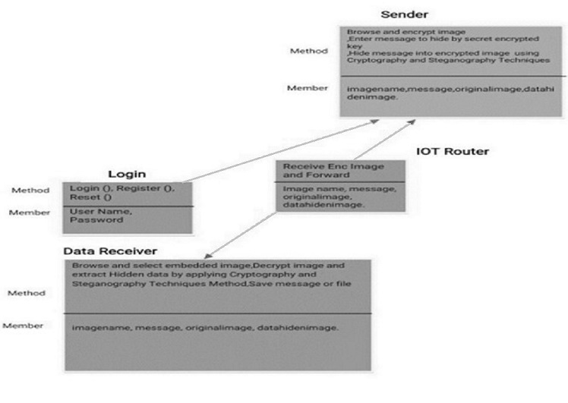
Class Diagram

Slide 13
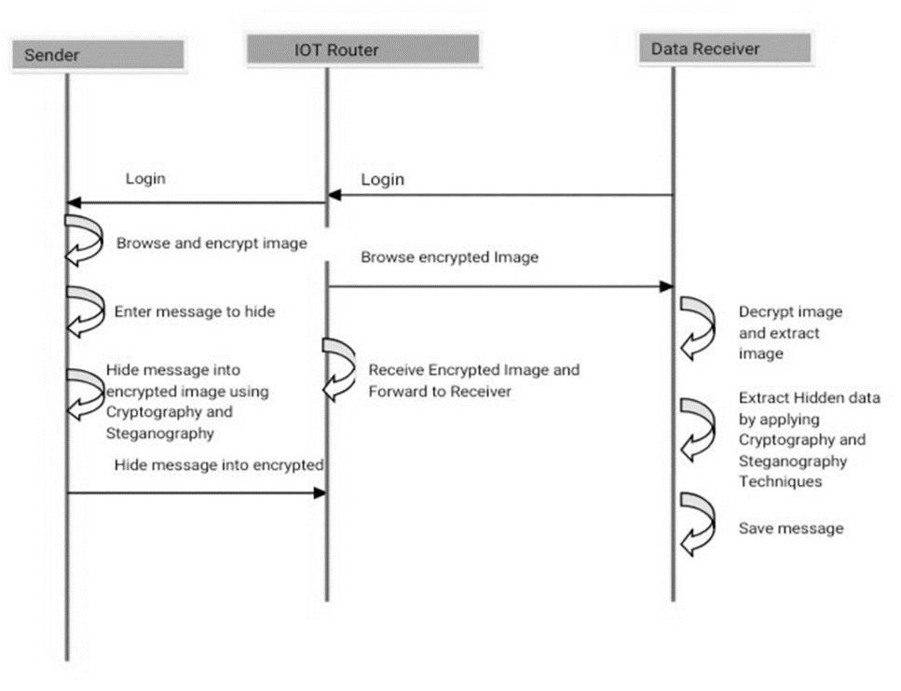
Sequence Diagram

Slide 14
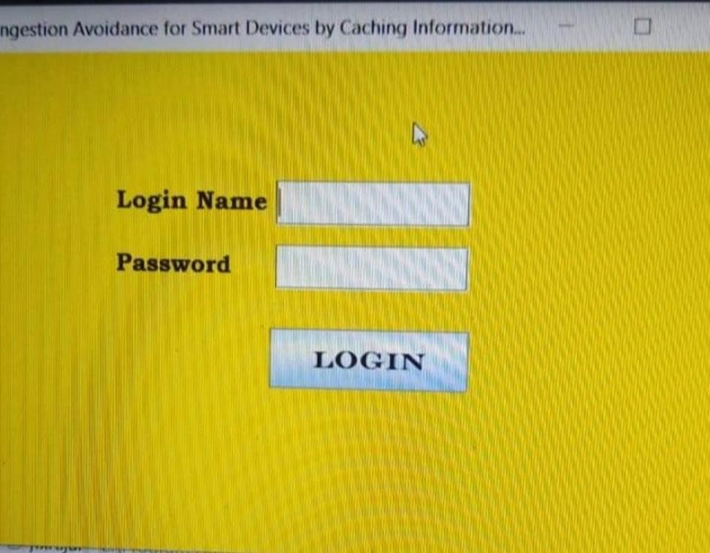
Screenshots (Login Page)

Slide 15
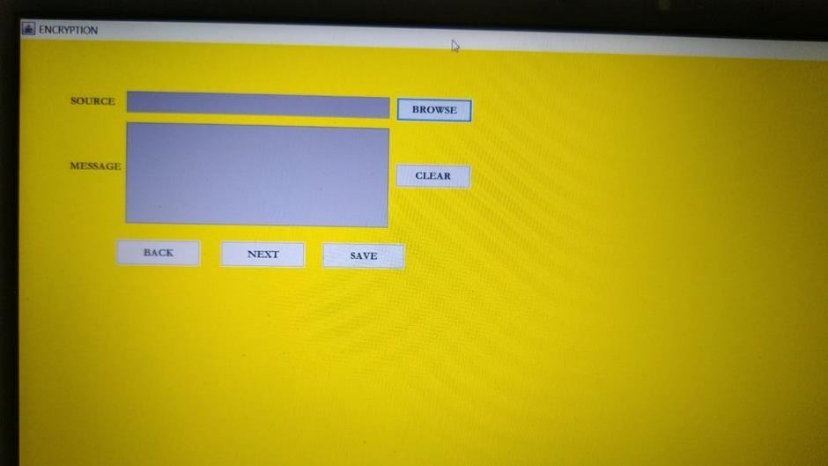
Encryption

Slide 16
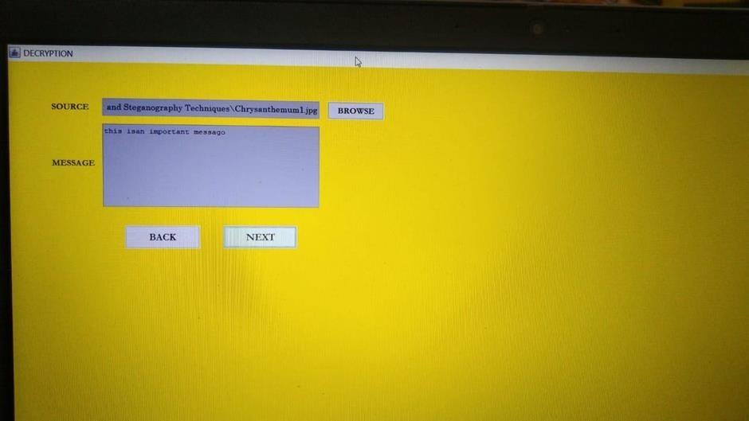
Decryption

Slide 17
CONCLUSION
In order to protect data during IOT transmission, the ECG protocol generated a high level of data security. The proposed ECG protocol improved security with the latest ECG on the Galois region. Because of the increased integration performance, advanced capabilities for hiding data are feasible. Due to the suggested specification and configuration of the adaptive firefly, some volume of the PSNR, carrier capacity, time complexity and the SSE are evaluated using parameters. Finally, the proposed work is implemented in a MATLAB simulator, and approximately 86% steganography embedding efficiency was achieved. Results from this proposed protocol were compared to existing methods, such as OMME, FMO, and LSB.

Slide 18
THANK YOU

